Slide 1


Initialisation of weights in SONN
=============================================================================
WWW.THEMLLABS.COM || contact@themllabs.com || Phone : 91-7338339898, 91-6362546088

Slide 2
Agenda
Self oragnizing networks (SONN)
SONN architecture
Weight initialization
=============================================================================
WWW.THEMLLABS.COM || contact@themllabs.com || Phone : 91-7338339898, 91-6362546088

Slide 3
Self organizing networks (SONN)
Self organizing neural networks are unsupervised learning model in ANN, it is termed as self-organizing feature maps or Kohonen maps.
These feature maps are the generated two dimensional discretized form of an input space during the training of a model.
These feature maps are used for classification and visualization of high-dimensional data in lower dimension.
=============================================================================
WWW.THEMLLABS.COM || contact@themllabs.com || Phone : 91-7338339898, 91-6362546088

Slide 4
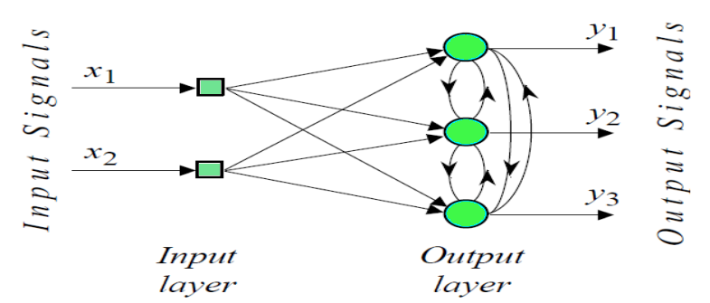
SONN architecture
=============================================================================
WWW.THEMLLABS.COM || contact@themllabs.com || Phone : 91-7338339898, 91-6362546088

Slide 5
Weight initialization in SONN
Self-organizing feature maps uses random initialization of weights.
It also uses principal component initialization, in which initial map weights are chosen from the space of the first principal components.
Principal component initialization is popular due to exact reproducibility of the results.
=============================================================================
WWW.THEMLLABS.COM || contact@themllabs.com || Phone : 91-7338339898, 91-6362546088

Slide 6
Advantages of principal component initialization over random initialization are not universal.
The best initialization method depends on the specific geometry of the datasets.
If the principle curve approximating the datasets can be univalently and linearly projected on the first principal component, then principal component initialization is preferred.
For non linear datasets, random initialization is preferred.
=============================================================================
WWW.THEMLLABS.COM || contact@themllabs.com || Phone : 91-7338339898, 91-6362546088

Slide 7
Thank you
=============================================================================
WWW.THEMLLABS.COM || contact@themllabs.com || Phone : 91-7338339898, 91-6362546088

